Slide 1
WORKSHOP
CSS
The Basic of Cascading Style Sheets

Slide 2
Rules
Man are curious by nature, when he face with things he yet understand, he should asketh.
Man who laugh at another's question, implying he who laugh fail to understand he too, once do not understand it.
Every man that hath attained to the use of reason, is supposed to know, he ought not to do to another, what he would not have done to himselfe

Slide 3
What is CSS?

Slide 5



Slide 6
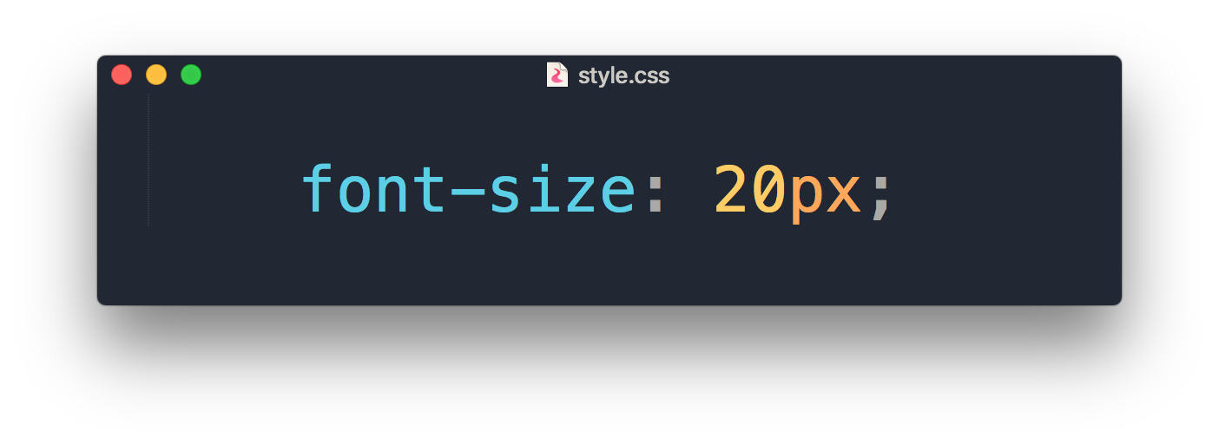
What is CSS?
Add styles like font, color, spacing
A totally different language to HTML

Slide 7
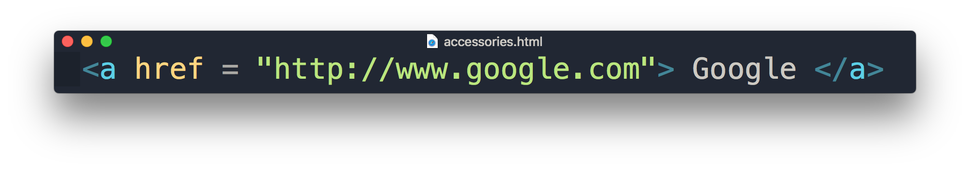
Recap HTML
Attribute
Content
Element

Slide 8
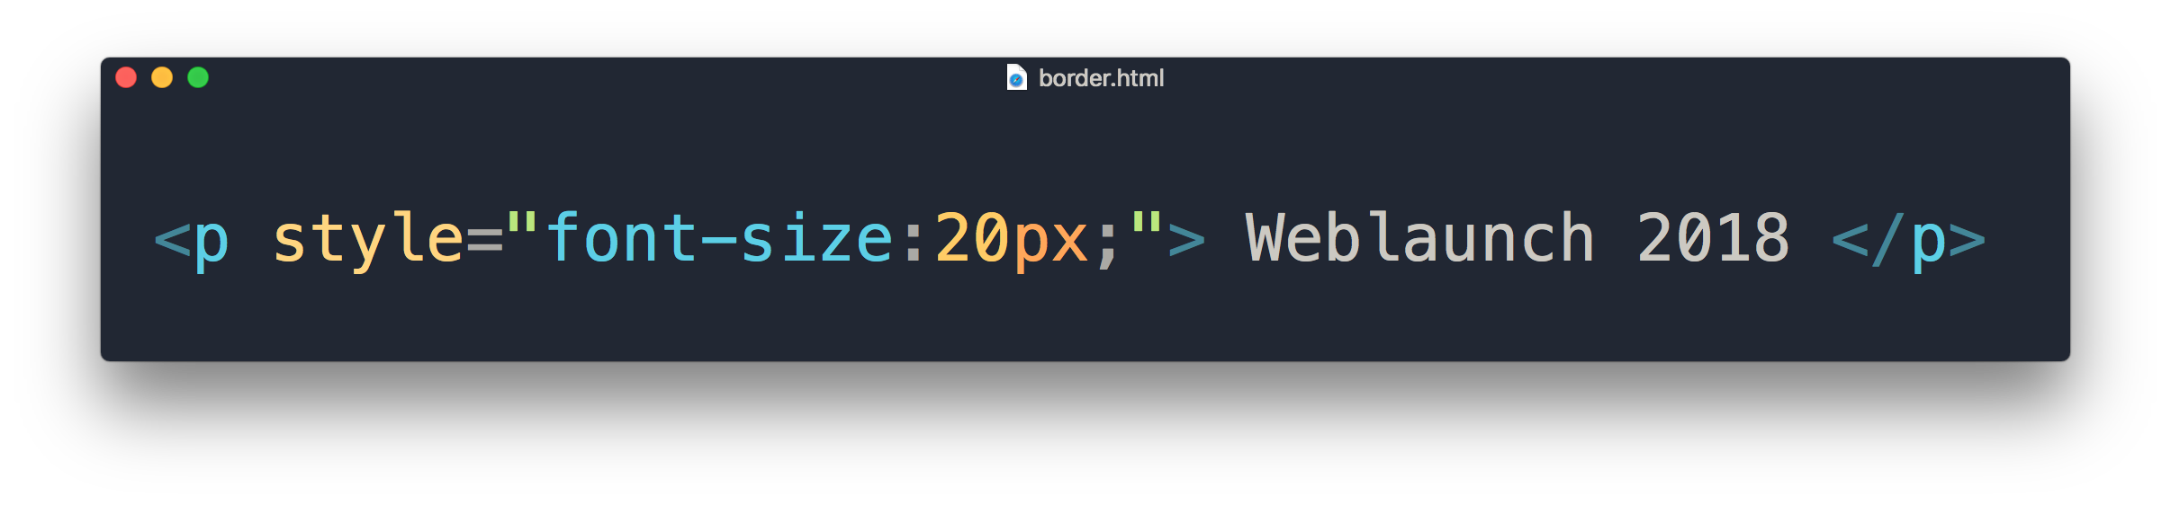
Inline Style Sheet
property
value
style attribute in HTML

Slide 9
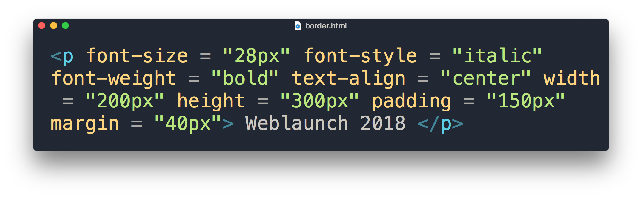
It will look like a mess

Slide 10
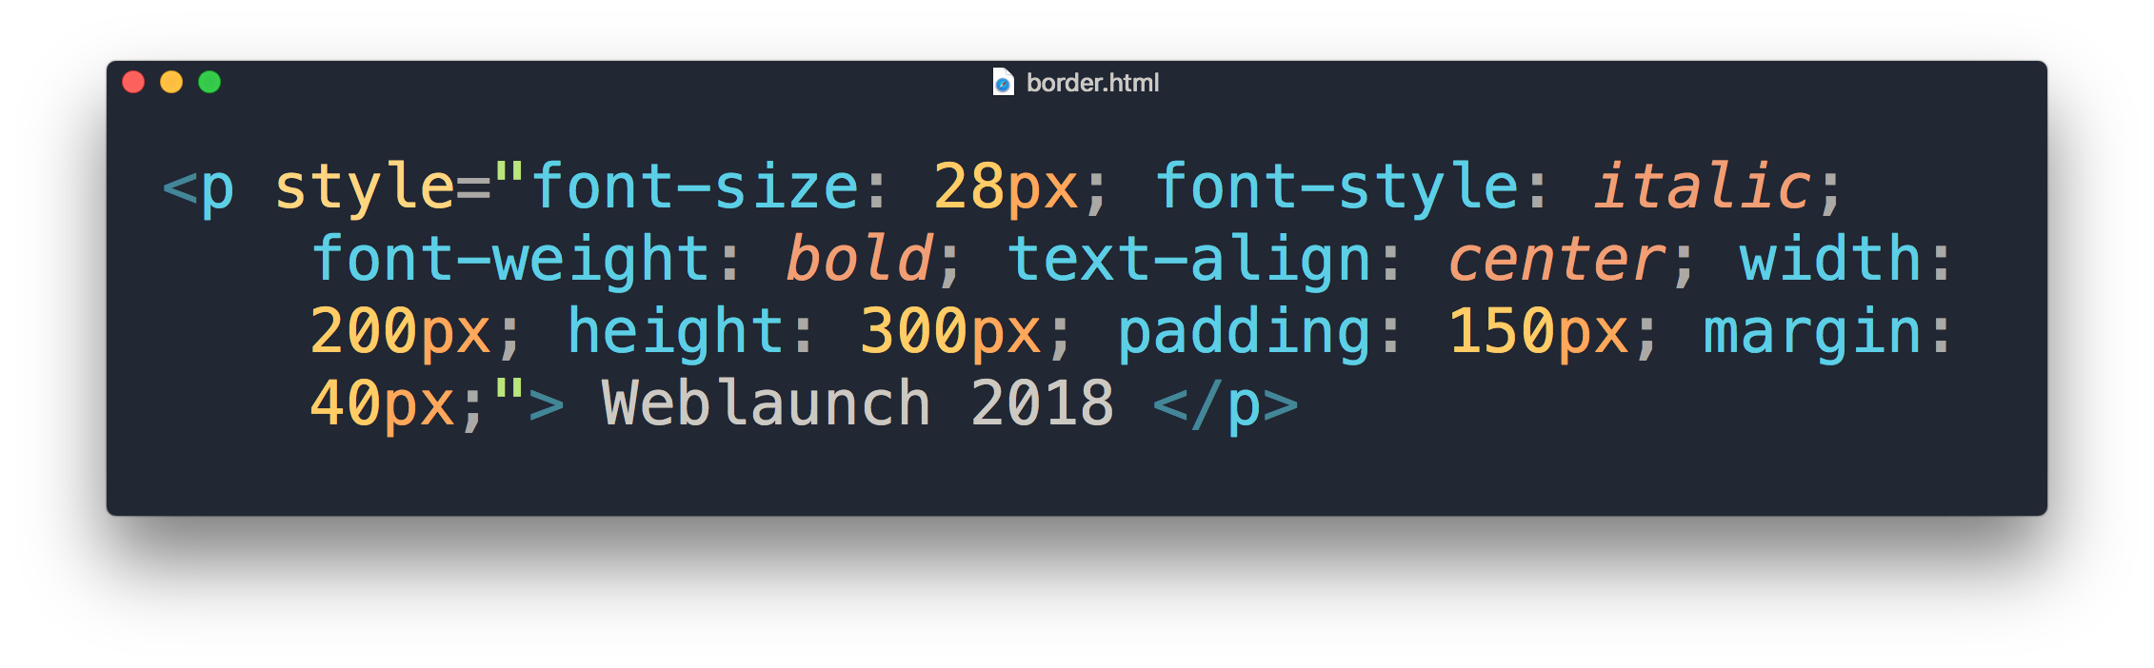
But inline would look like a mess too, right?

Slide 11
Types of CSS
Inline Style
Embedded Style
External Style

Slide 12
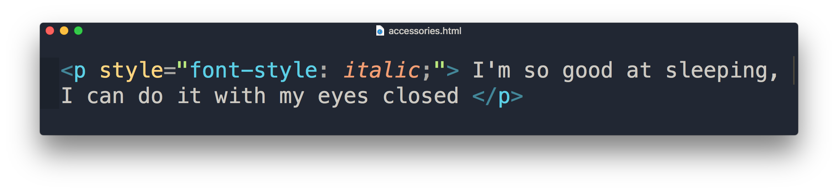
Inline Style Sheet
HTML style attribute
Only applies to specific element
Placed in <body> section

Slide 13
“What if I want it to apply to all <p> element in the rest of the page? "

Slide 14
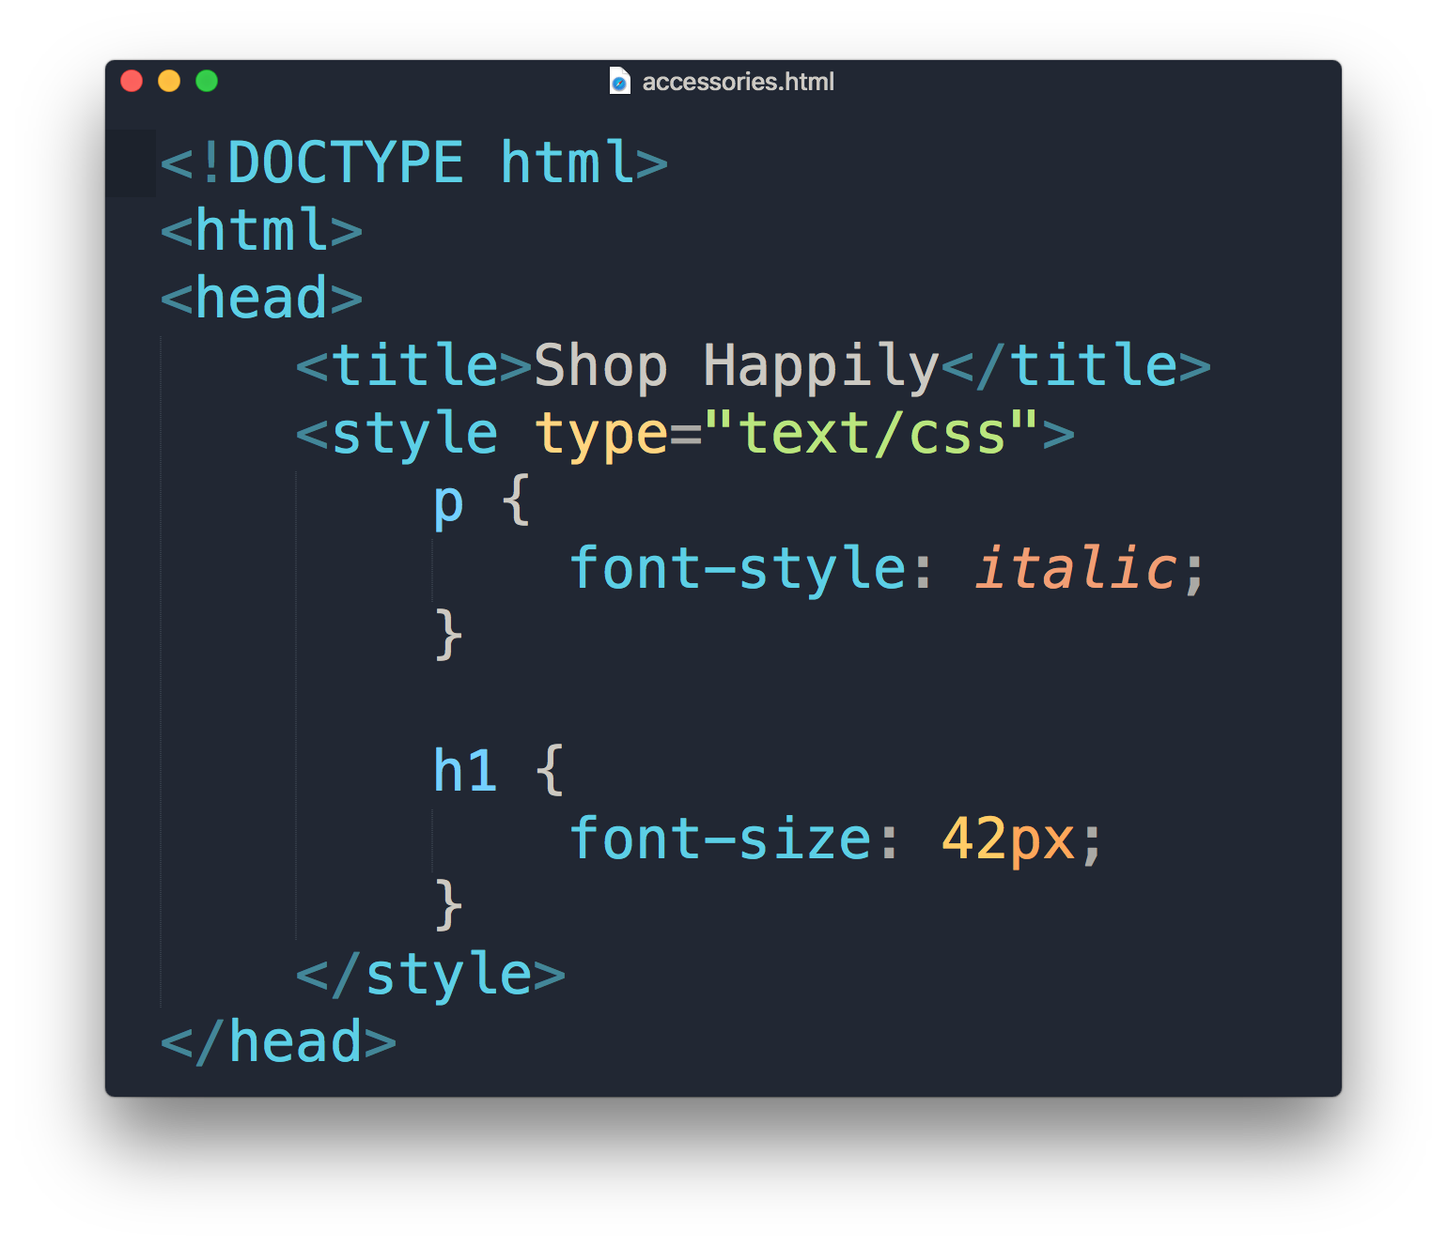
Embedded Style Sheet
HTML <style> element
Placed in <head> section
Requires selector
Only applies to a single HTML page document

Slide 15
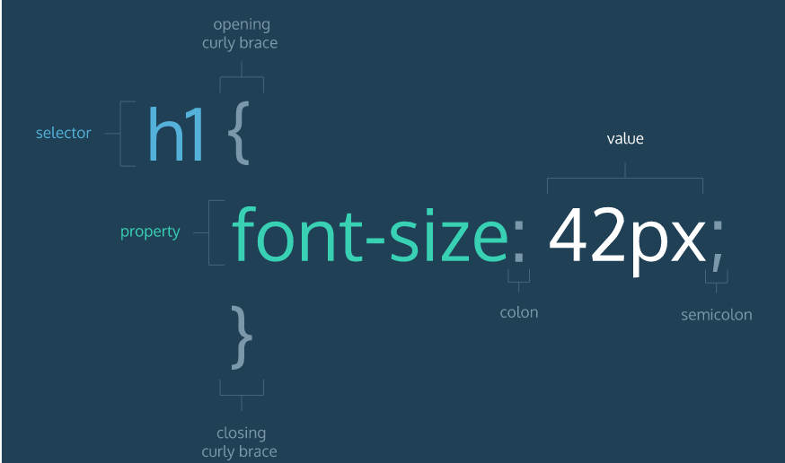
CSS format

Slide 16
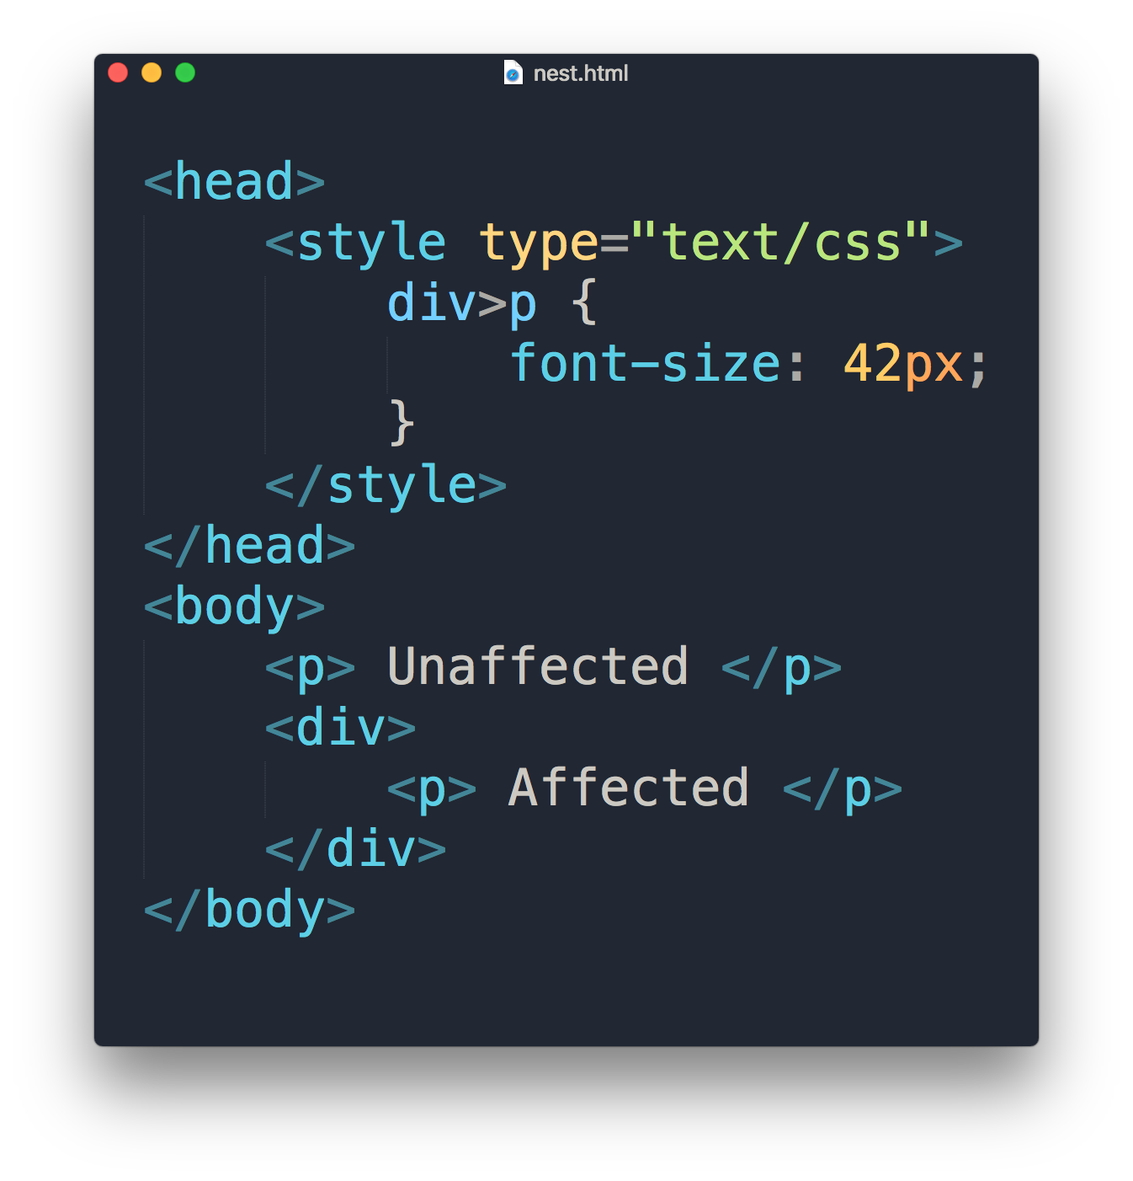


Slide 17
Selectors
div, p
div > p
div *
a:link
a:hover
a:visited
<p> tags and <div> tags
<p> one level deep in <div>
All tags inside <div>
Link in normal state
Link with mouse over it
Link in visited state

Slide 18
“What if I want to apply the same font-size in more than one html page? "

Slide 19
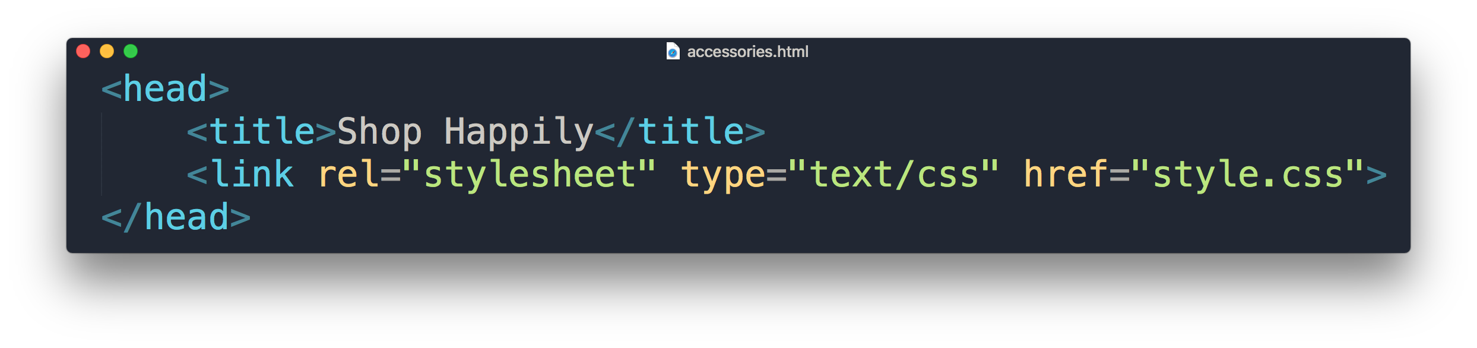
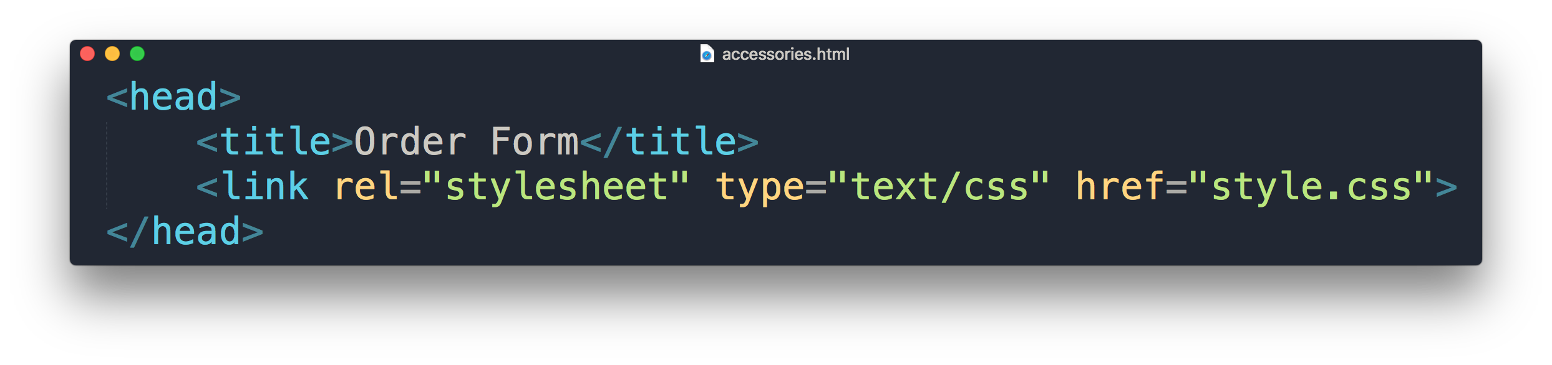
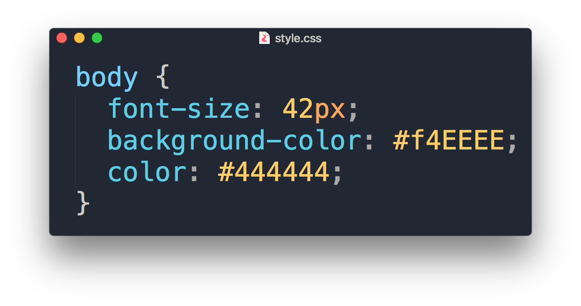
External Style Sheet
Separate HTML & CSS
Placed in <head> section
HTML <link> element to associate with .css file
Requires selector
Applies to multiple HTML page documents
What are these?

Slide 20
Hexadecimal Colors

Slide 21
Comparing Hex with RGB
Hexadecimals counts from 0 ~ 9 then A ~ F
RGB(255,0,0) = #FF0000
RGB(0,255,0) = #00FF00
RGB(0,0,255) = #0000FF
See the pattern?
Red
Green
Blue

Slide 22
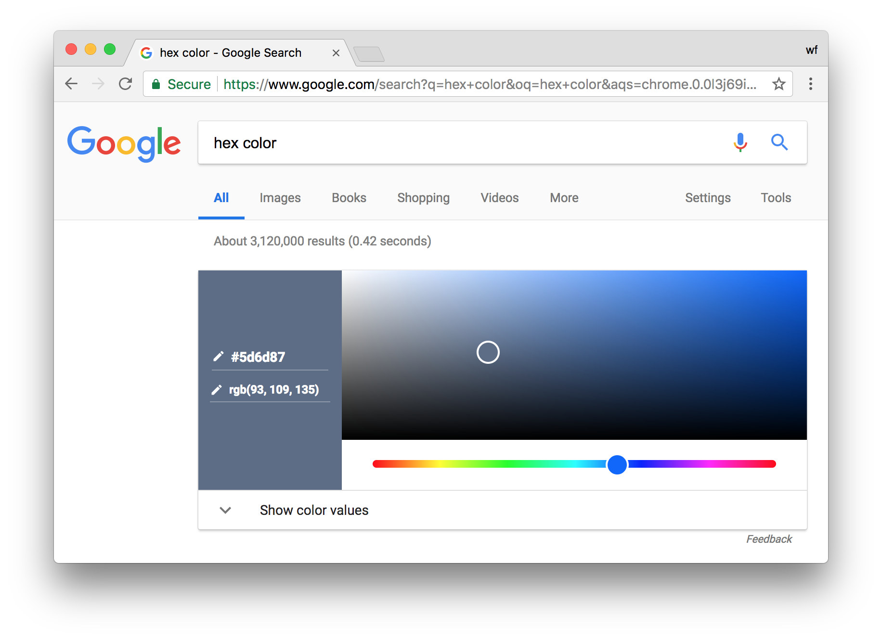
Google ‘hex color'

Slide 23
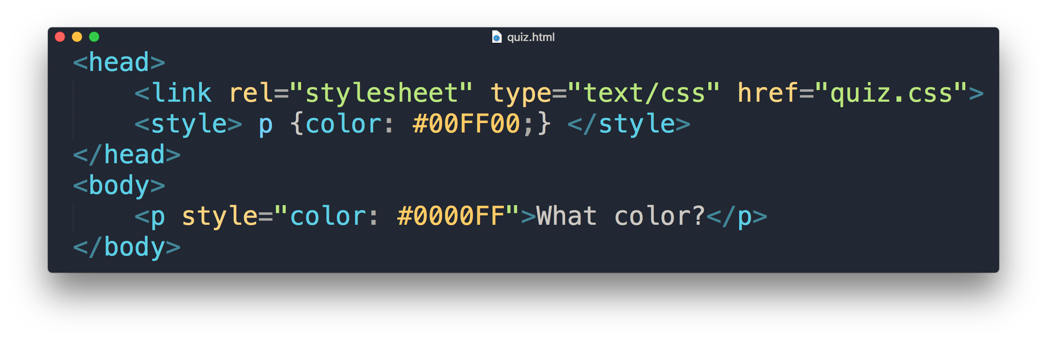
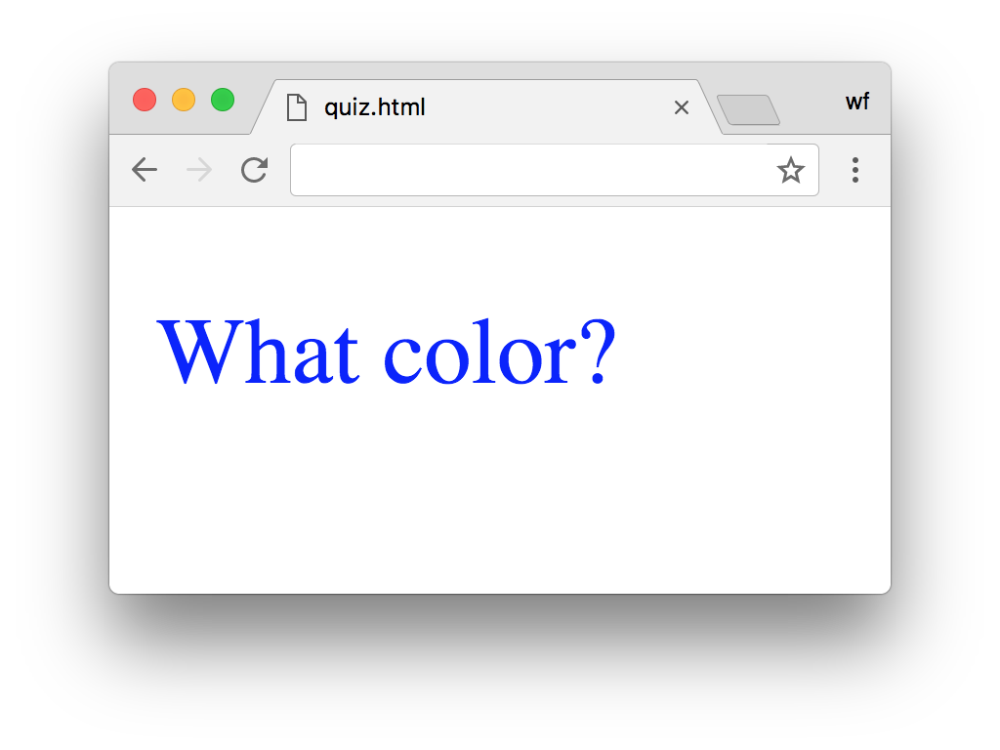
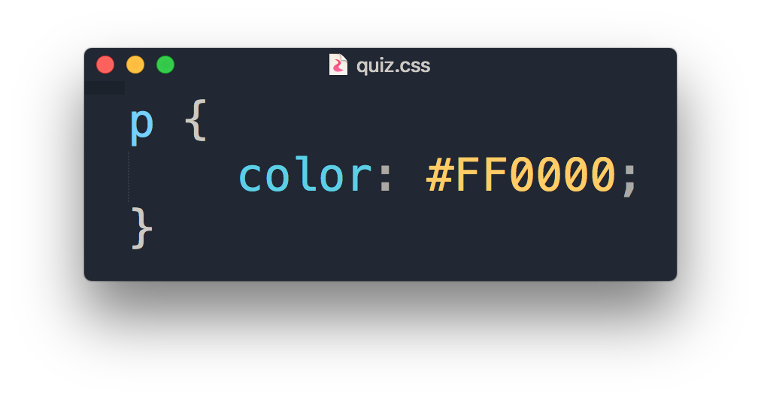
Quiz
What is the color of the output?

Slide 24
“What if I want to apply different font-sizes in two different <p> elements with external style? “

Slide 25
.class
Can use same class on multiple elements.
Can use multiple classes on the same element.
To consistently style different elements.
#id
Can only be used on one element.
Each element can only have one ID.
To style single unique element.

Slide 26
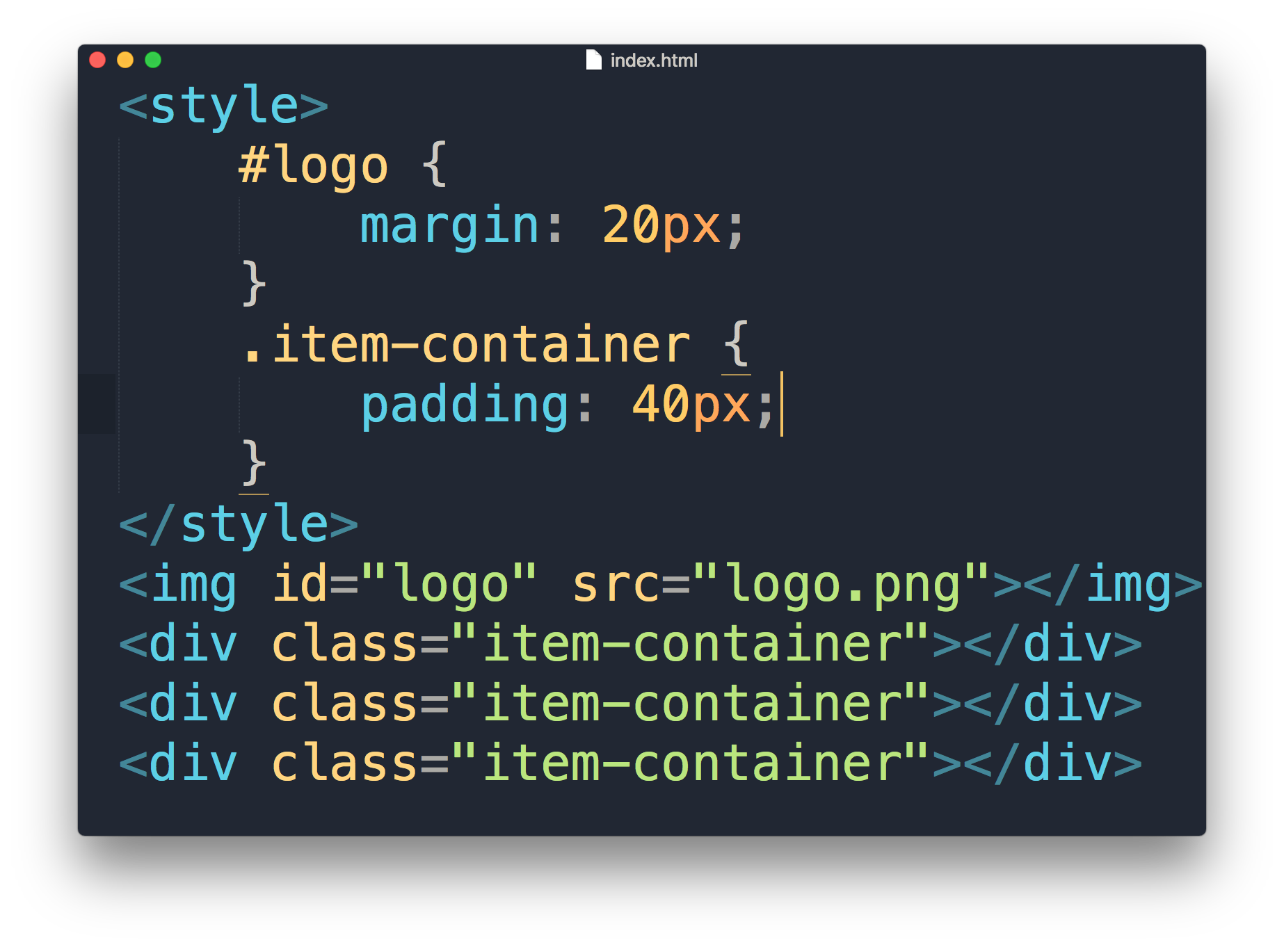
Class & ID

Slide 27
COMMONLY USED CSS

Slide 28
COMMONLY USED CSS
Text and fonts
font-size
font-weight
font-family
text-align
text-decoration
The Box Model
padding
margin
border
border-radius
Visual Formatting
width
height
display
Colors and Background
background-color
color
box-shadow

Slide 29
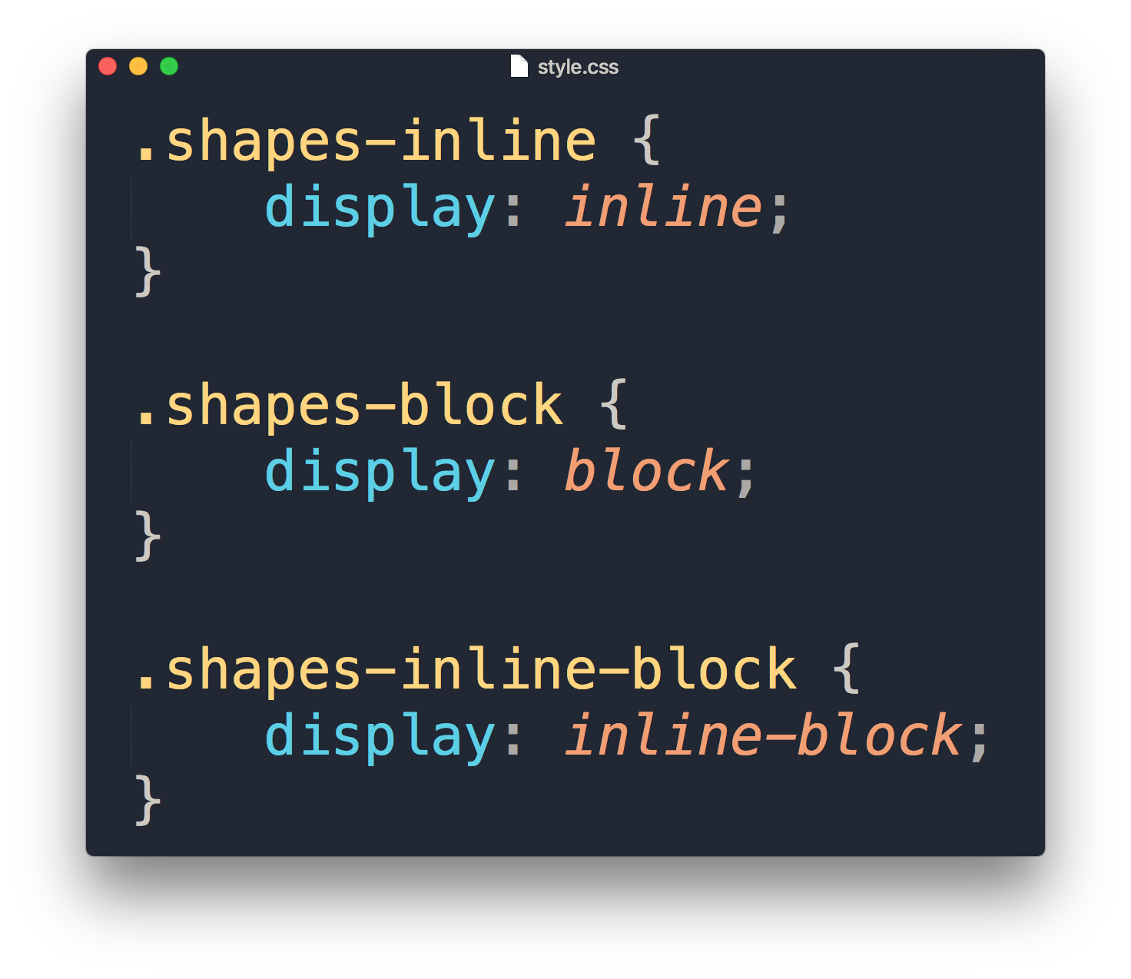
Display property
1
2
1
2
1
2

Slide 30
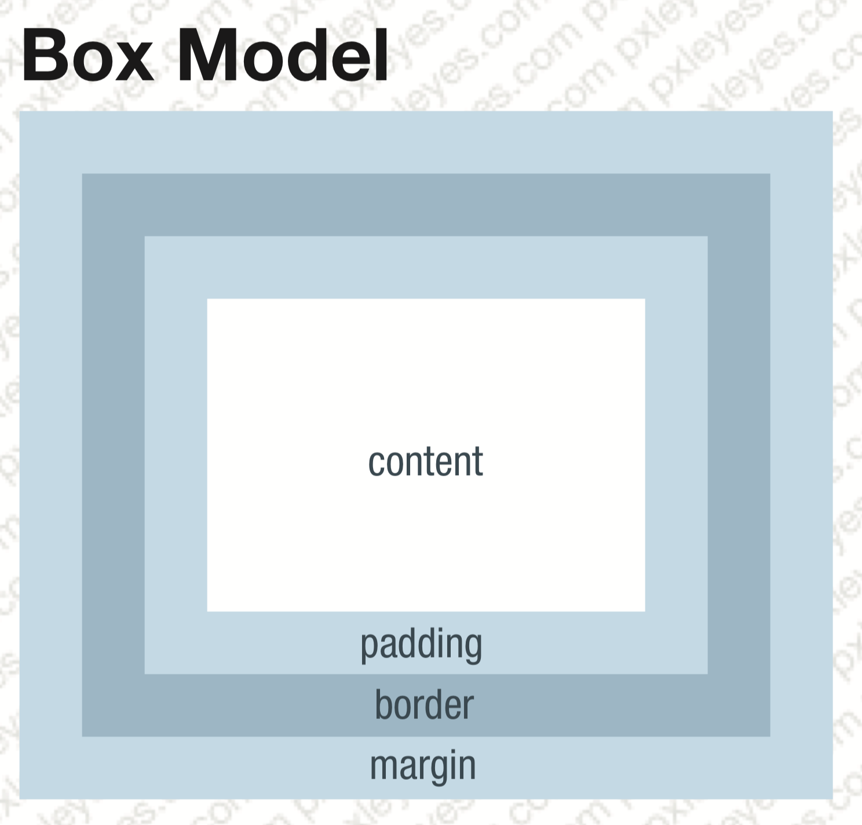
Margin & Padding

Slide 31
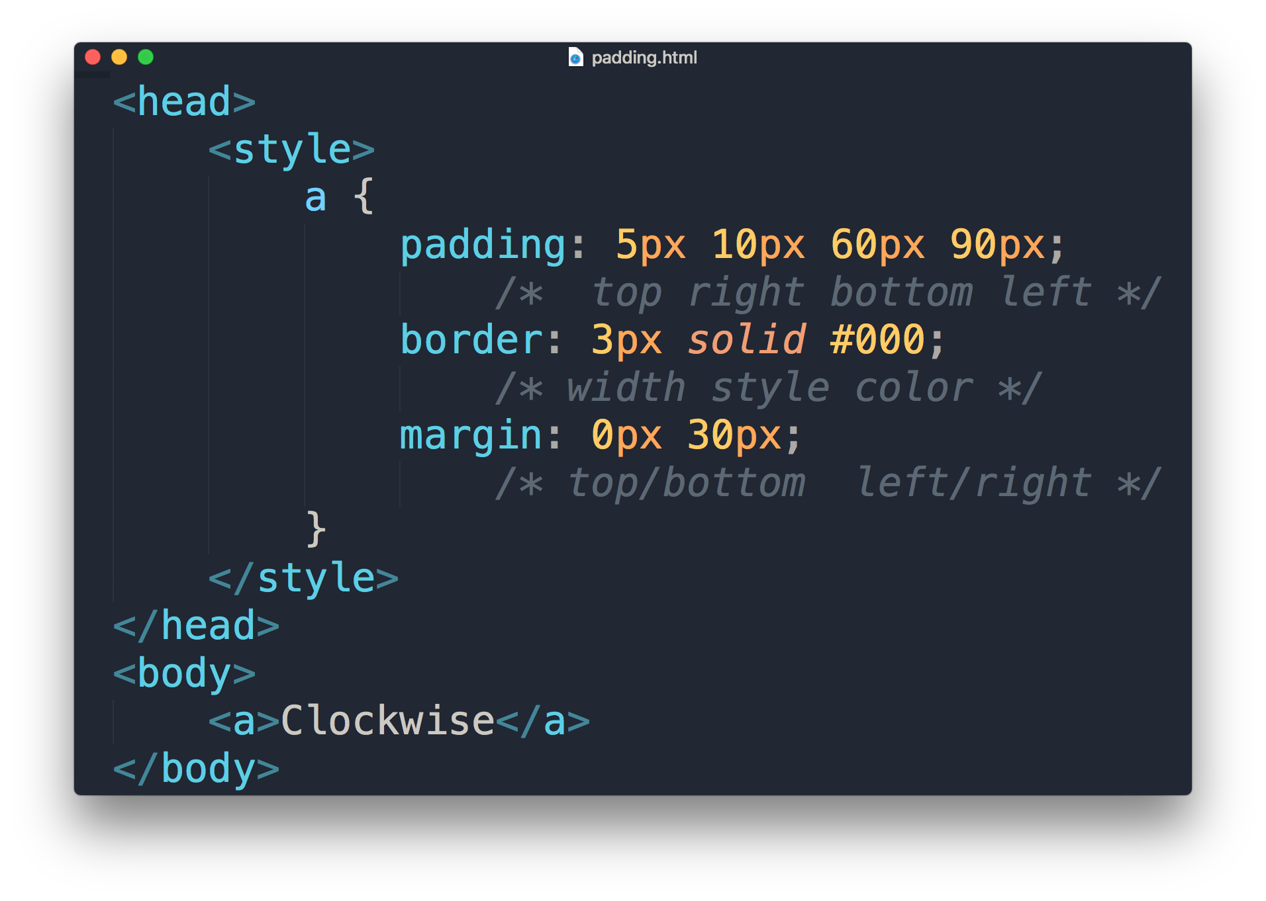
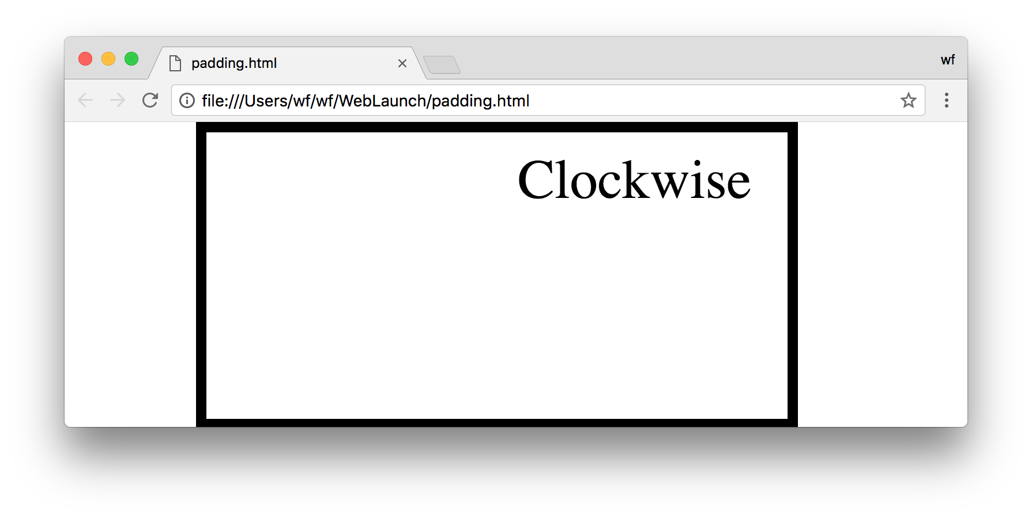
Margin & Padding
values
5px
30px
90px
30px
10px
60px

Slide 32
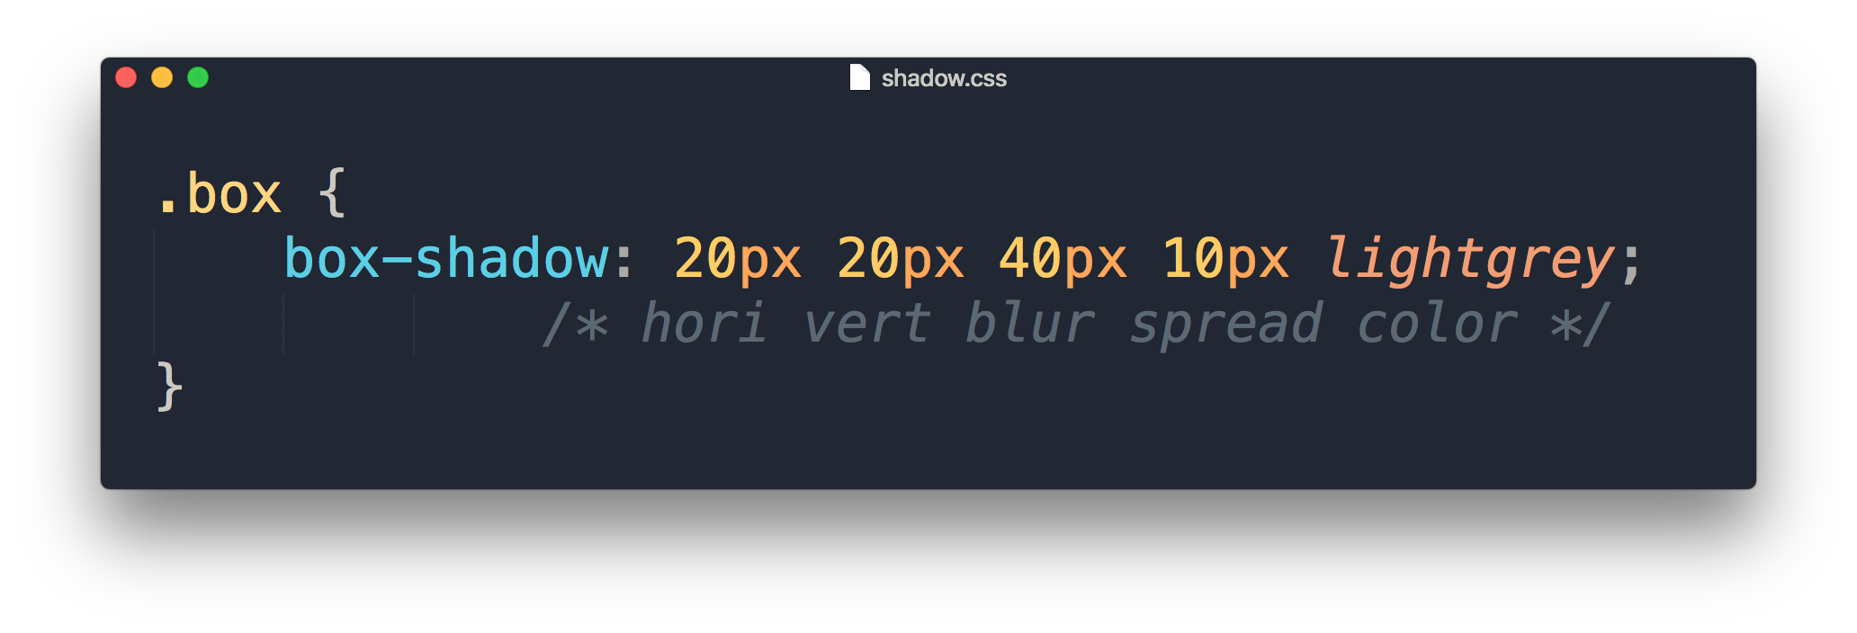
Box Shadow
values
Vertical offset
Horizontal offset
1

Slide 33
Demonstration

